Slide 1
Simple Rules for Open Economies
John B. Taylor
Stanford University
Norges Bank Conference
“On the Use of Simple Rules as Guidelines for Policy Decisions”
24 June 2010

Slide 2
Origins of Modern Research on Rules to Guide Interest Rate Decisions
Normative rules first derived from empirical models with rational expectations and sticky prices constructed in the 1970s and 1980s
  Built on work of Fisher, Wicksell, Friedman
  Objective was to find a monetary policy rule which cushioned the economy from shocks and did not cause its own shocks.
  Optimal among a class of rules (fully optimal in simple models) with output stability and price stability in objective function
Taylor Rule is an example

Slide 3
Good Progress Over Past Two Decades
Research has shown that simple rules are robust
  Work well over a wide range of models
Experience has shown that simple rules have worked well in the real world:
  Good performance when policy was close to rule
  Poor performance when policy was far away from rule
Progress made in understanding the effects of adjusting simple rules to deal with
  Measurement error
  Expectations
  Lower bound on interest rates
Less progress on policy rules for open economies

Slide 4
Woodford, Rotemberg (1997)
Levin Wieland Williams (2003)
Clarida Gali Gertler (1999)
Clarida Gali Gertler 2-Country (2002)
McCallum, Nelson (1999)
Fuhrer & Moore (1995)
FRB Monetary Studies, Orphanides, Wieland (1998)
FRB-US model linearized by Levin, Wieland, Williams (2003)
CEE/ACEL Altig, Christiano, Eichenbaum, Linde (2004)
FRB-US model 08 mixed expectations, linearized by Laubach (2008)
Smets Wouters (2007)
New Fed US Model by Edge Kiley Laforte (2007)
Coenen Wieland (2005) (Taylor or Fuhrer-Moore stag. Contracts)
ECB Area Wide model linearized by Kuester & Wieland (2005)
Smets and Wouters (2003)
Euro Area Model of Sveriges Riksbank (Adolfson et al. 2008a)
QUEST III: Euro Area Model of the DG-ECFIN EU
ECB New-Area Wide Model of Coenen, McAdam, Straub (2008)
RAMSES Model of Sveriges Riskbank, Adolfson et al.(2008b)
Taylor (1993) G7 countries
Coenen and Wieland (2002, 2003) G3 countries
IMF model of euro area Laxton & Pesenti (2003)
FRB-SIGMA Erceg Gust Guerrieri (2008)
Small Calibrated
Models
Estimated U.S.
Models
Estimated Models
For Other
Countries or Areas
Estimated
Multi-Country
Models

Slide 5
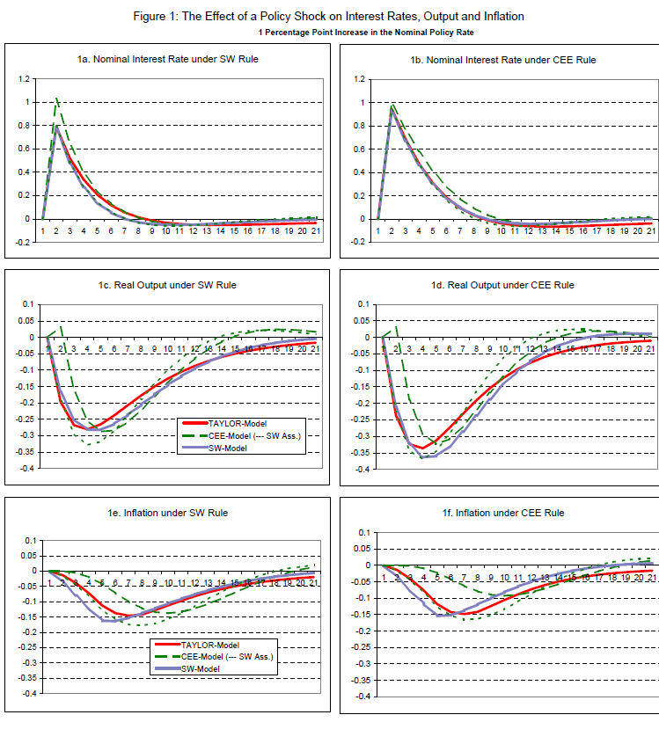

Slide 6
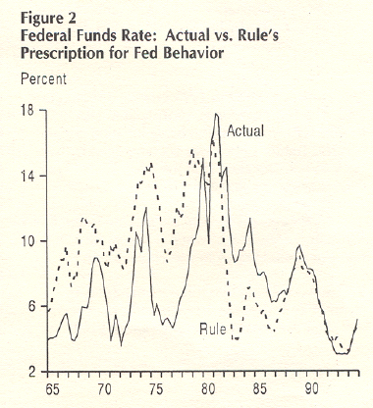
From “Has the Fed Gotten Tougher on Inflation?” The FRBSF Weekly Letter, March 31, 1995, by John P Judd and Bharat Trehan of the San Francisco Fed
1965-79
1987-92
1993-94

Slide 7
Source: Levin – Taylor (2009)

Slide 8
From William Poole, “Understanding the Fed”
St. Louis Fed Review, Jan/Feb 2007

Slide 9
From Great Moderation to Great Recession
Great Moderation
period
Great Recession
(End of Great Moderation?)

Slide 10
Do the Crises Call for a New Theory?
Recent crises give no reason abandon the core “rational expectations/sticky price” model developed over the past 30 years
  Framework did not fail in its recommendations for rules-based monetary policies or for its ideas
  Important not to confuse useful simplified versions with models needed for policy: time varying risk premia in term structure of interest rates, exchange rate channel, open economy.
Of course, try to improve whatever parts need to be improved including risk premia and bank credit flows
Need more work on “political macroeconomics.”
  First need to explain why some did not follow the recommendations.
  Practical solutions should then follow.

Slide 11
Rules for Open Economies without External Variables
Rules that do not respond to external variables may actually work well in open economies
  In fact, open economy models were used to derive and test such rules.
Why did they seem to work well in such models?
  Exchange rate change is built in:
  depreciation of exchange rate increases inflation and thus calls for higher interest rate;
  also long term interest rates adjust to expectations of exchange rate changes through effects on inflation and interest rates
  Exchange rates are volatile so directly reacting to them may increase interest rate volatility

Slide 12
But experience shows central banks
do respond to external variables
Example from Sebastian Edwards (2005) “The Relationship
Between Exchange Rates and Inflation Targeting Revisited”

Slide 13
Continued from Sebastian Edwards (2005)

Slide 14
Example from Large Open Economies:
ECB During 2000-2006
Sample 2000.1 - 2006.4.
Inflation = 4-quarter rate of change in the harmonized index of consumer prices
GDP gap = % deviation of real GDP from HP trend.
Regress deviation of ECB rate from Taylor rule on federal funds rate.
Estimated coefficient = .21
  standard error of .06.
  Plot of the actual and fitted values from this regression:

Slide 16
Source: Ahrend, Cournède and Price, OECD (2008)

Slide 17
Policy Rate Accounting
Norges Bank very explicit and transparent in accounting for how external variables affect interest rate path
Useful to consider several episodes in past few years…

Slide 18
Policy rate in MPR 1/08 (with fan chart) and the increase in the policy rate in MPR 2/08 (red line)
90%
70%
50%
30%
Source: Norges Bank

Slide 19
Factors behind changes in the interest rate path from MPR 1/08 to MPR 2/08
Higher demand in Norway
Higher inflation in Norway
Higher interest rates abroad and developments in the foreign exchange market
Lower growth abroad
Higher risk premium in the money market

Slide 20
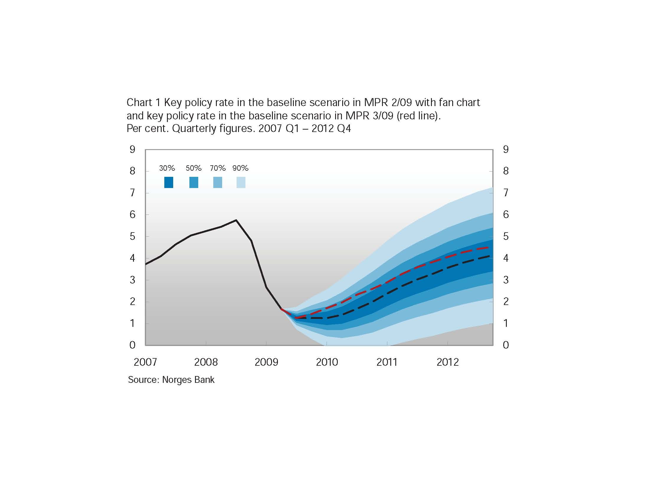

Slide 21
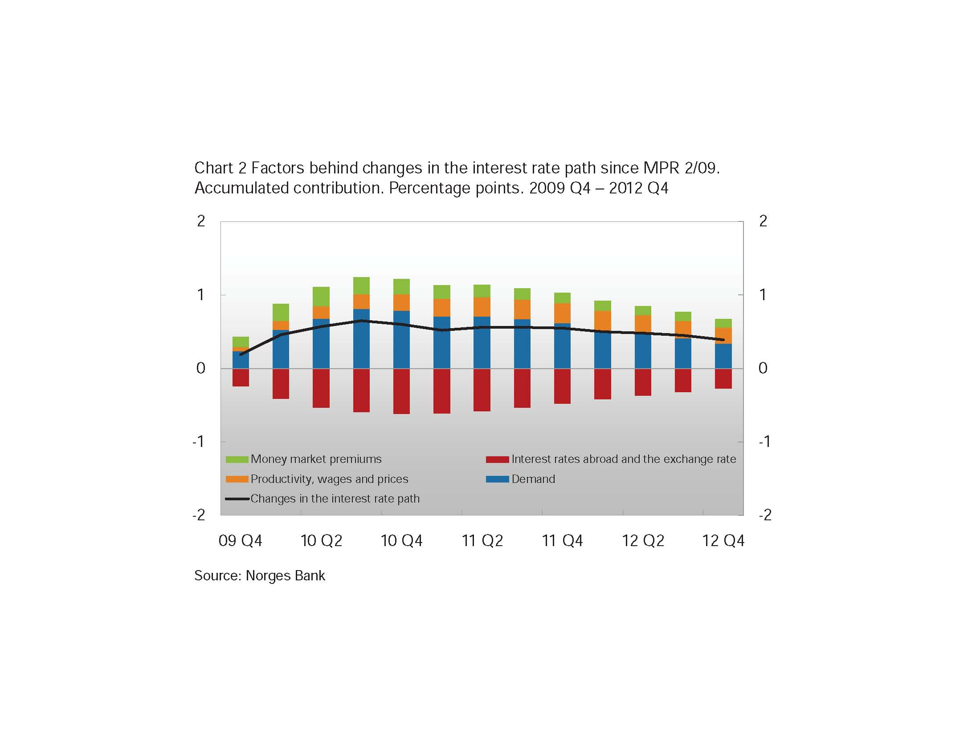

Slide 22
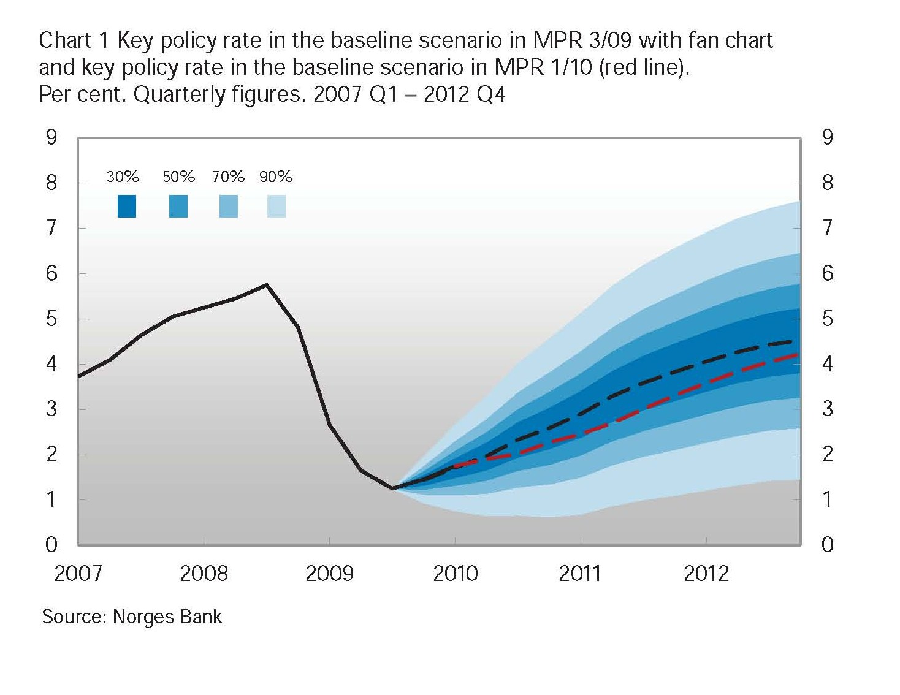

Slide 23
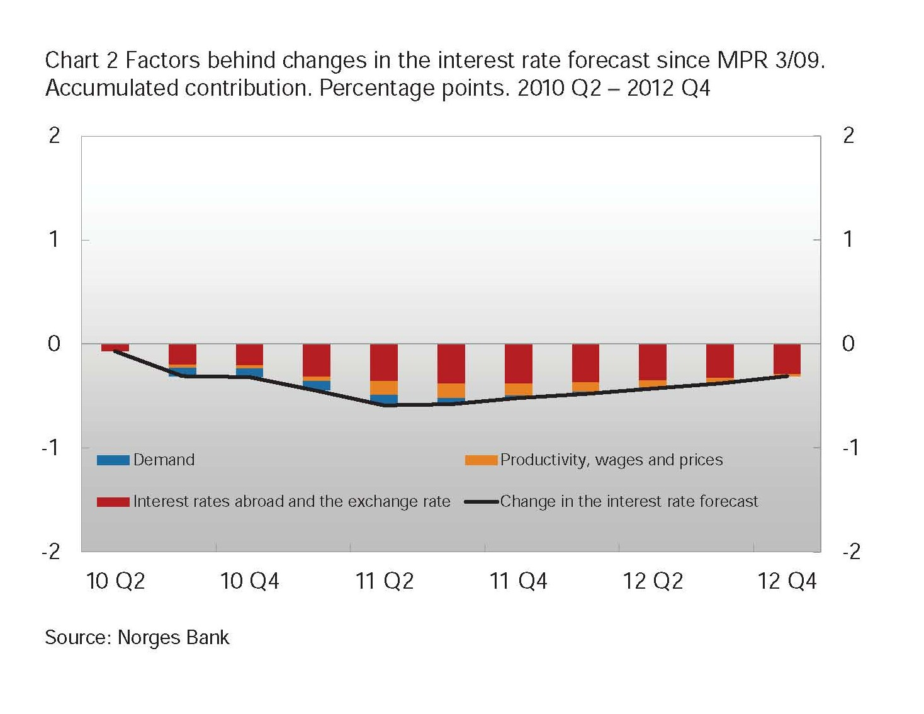
From 1-10

Slide 24
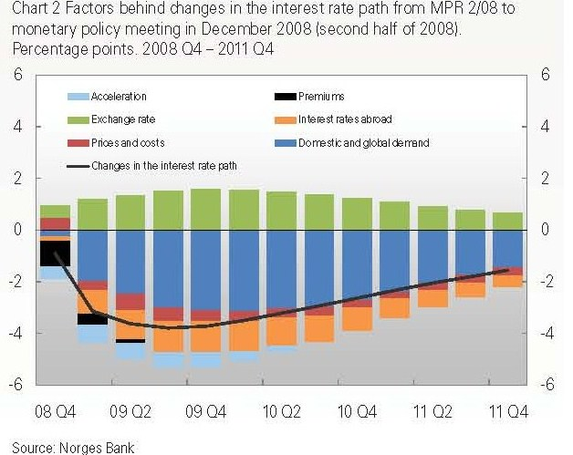

Slide 25
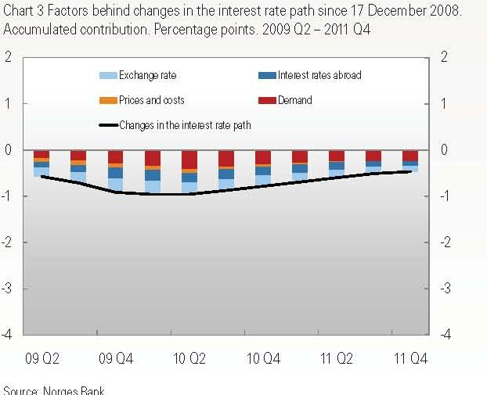

Slide 26
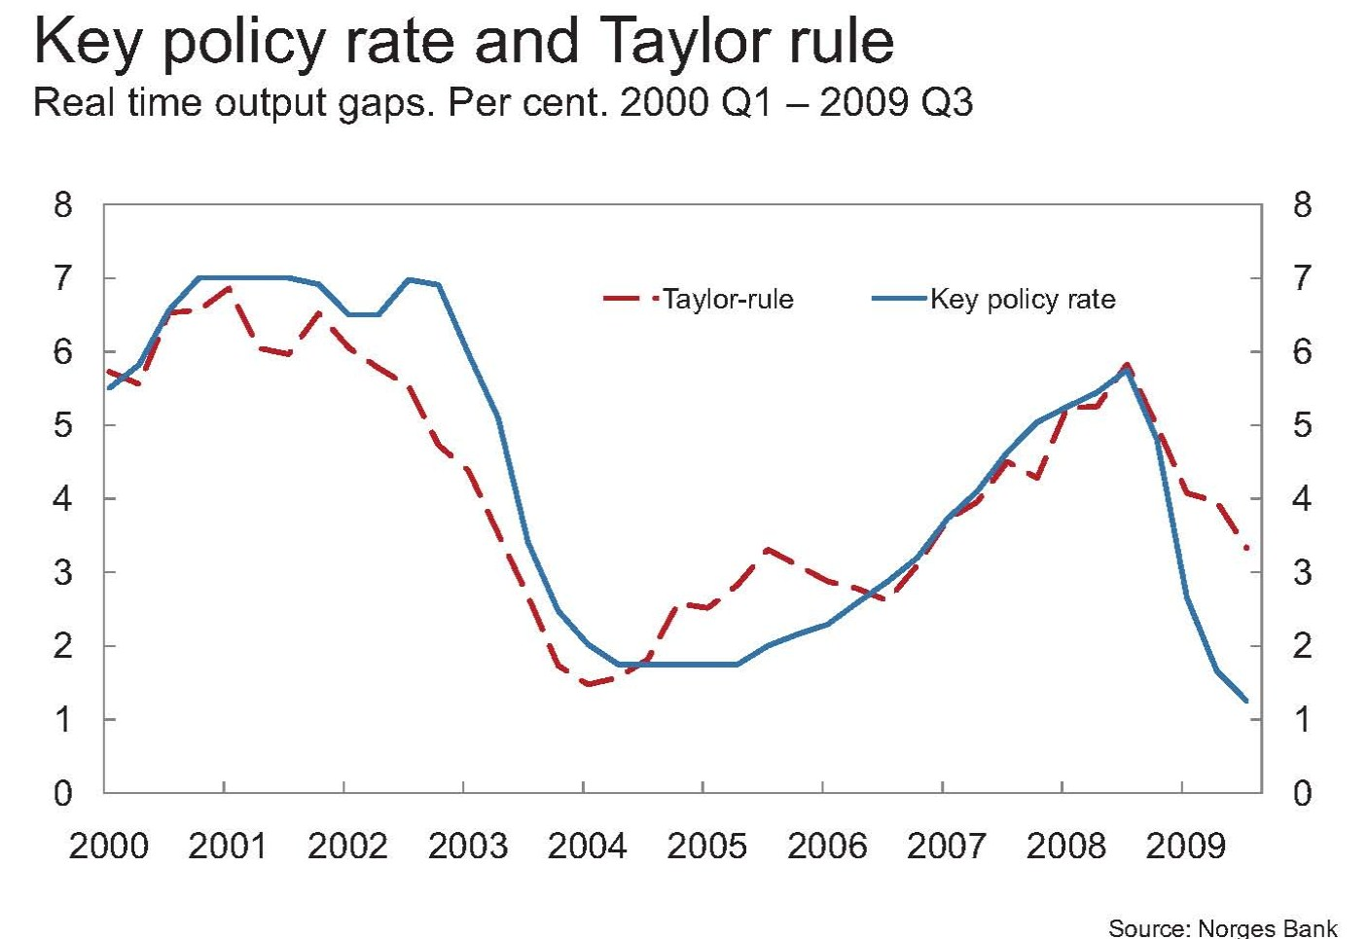
presentation by Øistein Røisland
“Monetary Policy in Norway”

Slide 27
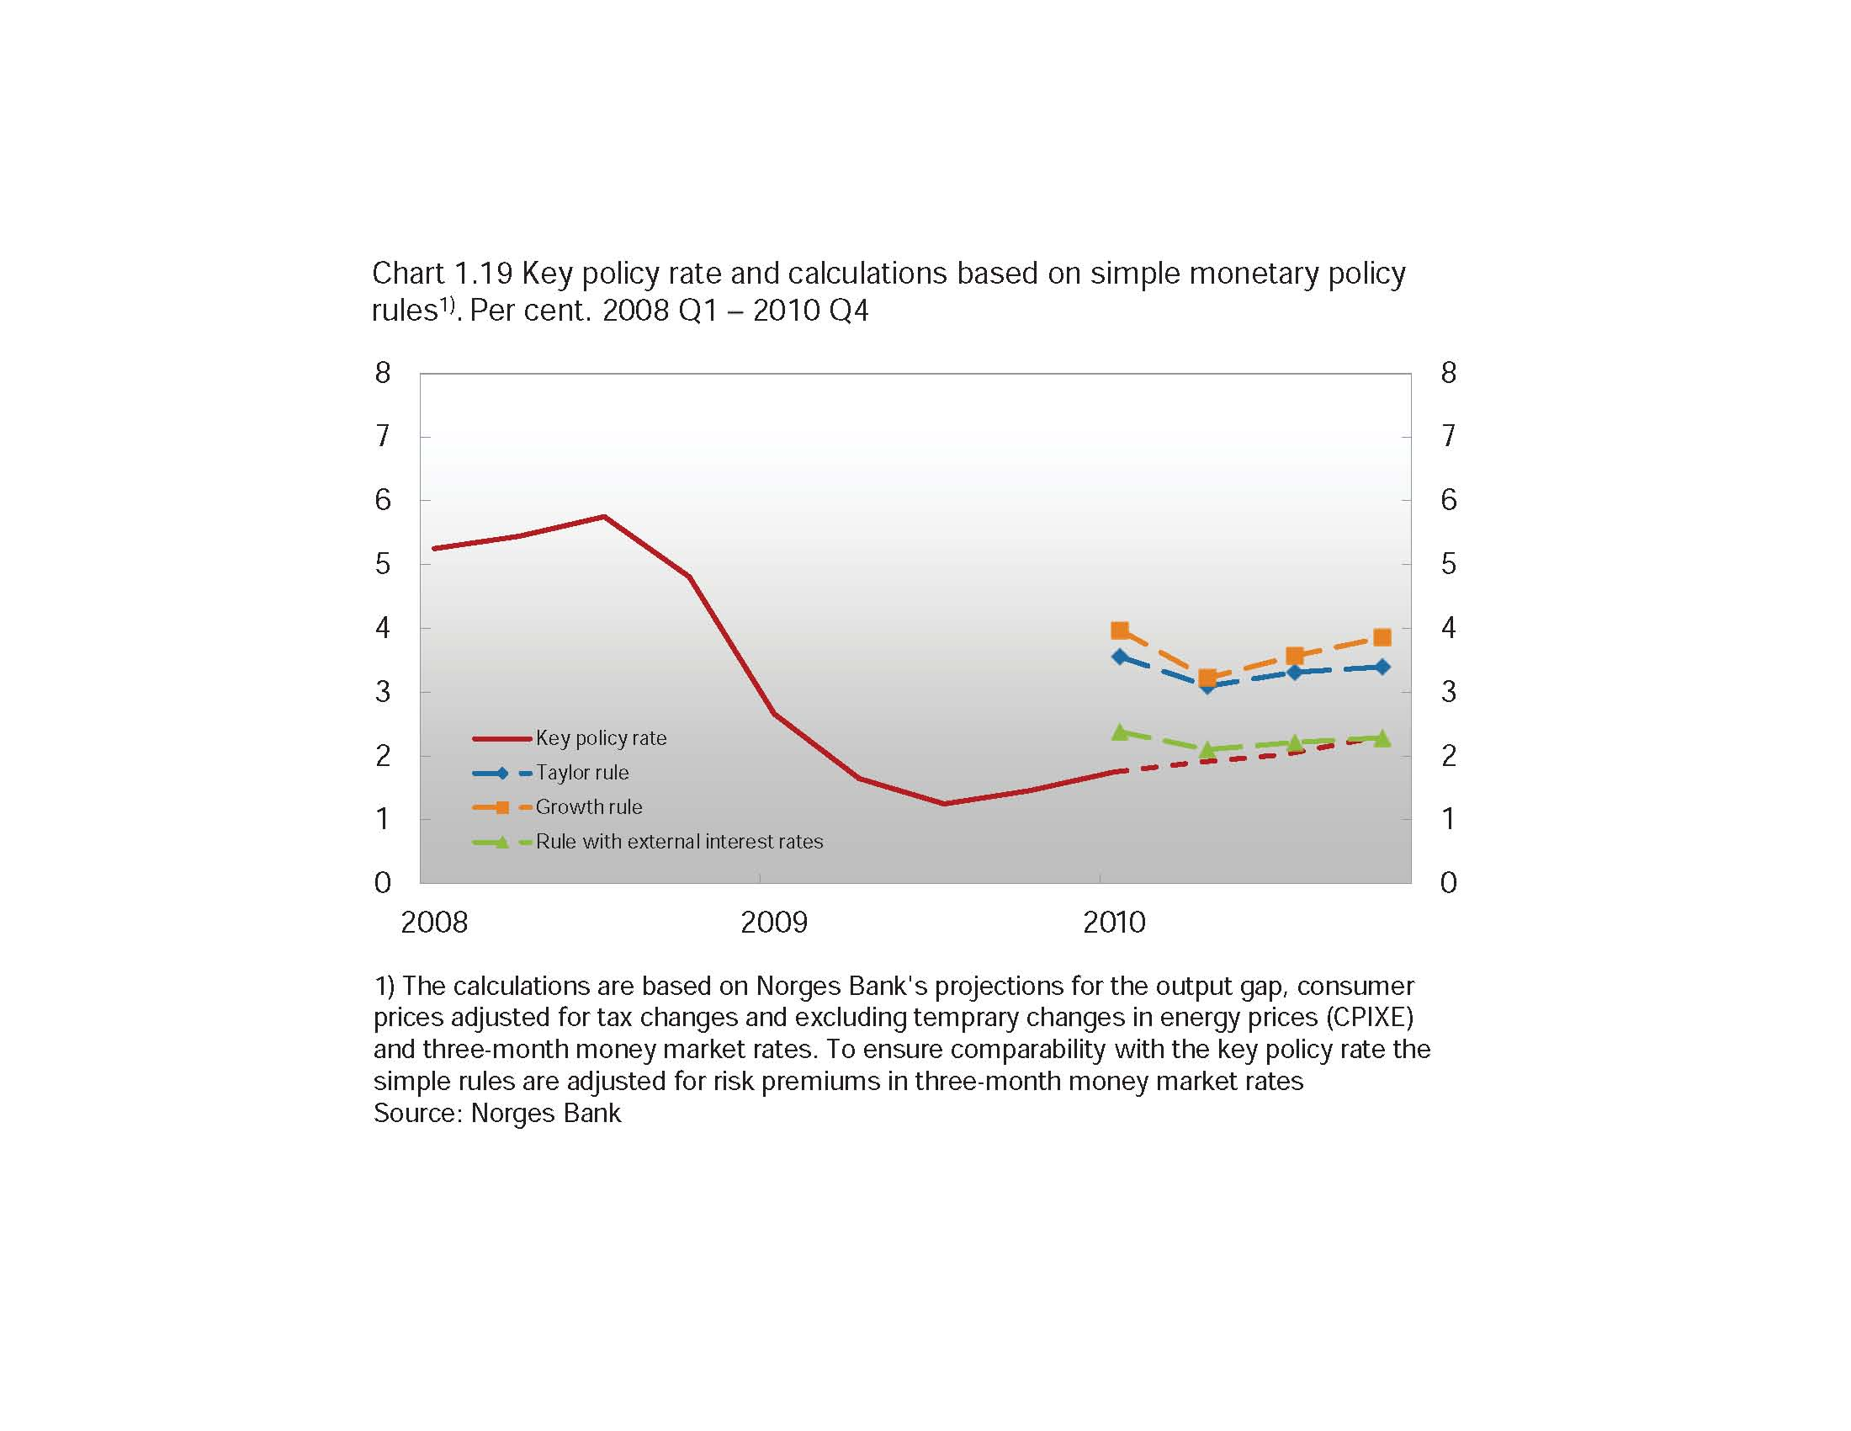
From MPR 1/10

Slide 28
Gleaning Some Stylized Facts
External variables are the main factors affecting decisions other than domestic output and inflation
  Another factor is the risk premium in the money market
Response to external variables is due to the effect of
  (1) “higher key policy rates among trading partners, through effects on the krone exchange rate” and
  (2) “the development in the krone exchange ...over and above the effects of changes in interest rate expectations abroad.”
Responses to the exchange rate and the foreign interest rate have opposite signs: positive for foreign interest rate; negative for exchange rate
Foreign interest rate is the main reason why optimal policy and simple rules are different

Slide 29
How Can We More Formally Incorporate External Variables into Policy Rules for Open Economies?
(1) Formally justify deviations from the closed economy policy rule: look at squared deviations from policy rule combined with deviations from output and inflation targets in the objective function
L = (π_{t} – π*)² + λy_{t}² + γ (r_{t} – r_{t-1})² + κ(r_{t} – r_{t}^{T})²
  Alstadheim, Bache, Holmsen and Røisland (2010)
(2) Add terms to the rule
  Straight forward to add interest rate spreads (Taylor 2008), Woodford-Curia (2008).
  Could also add foreign interest rate term in the model
    Example: OECD considers: interest rate =inflation target + equilibrium real interest rate + 1.5 x(inflation – inflation target) + 0.5 x Output gap + 1.0x (real interest rate among trading partners – real interest rate in Norway)

Slide 30
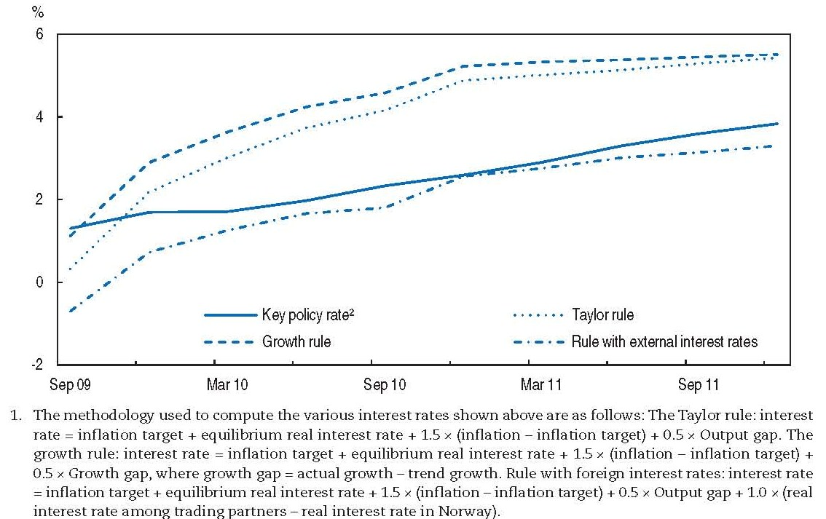
From OECD Survey Norway, 2010

Slide 31
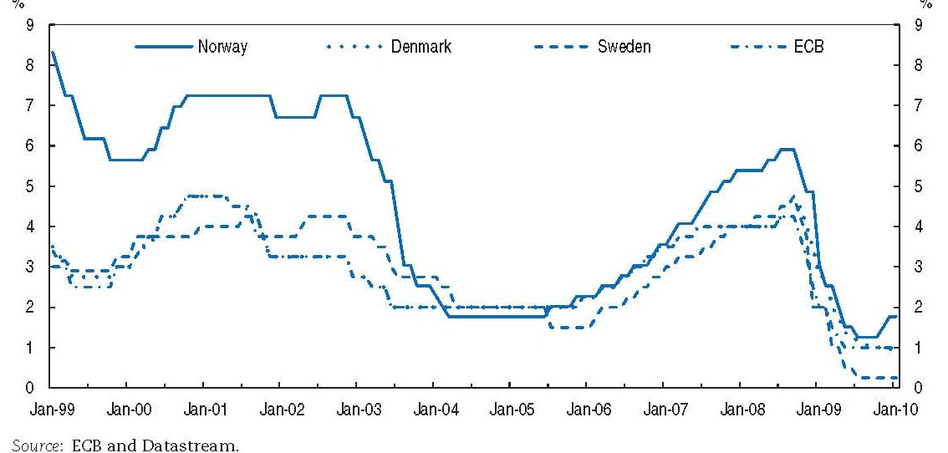
From OECD Survey Norway, 2010

Slide 32
Small Open Economy Assumptions
Add ROW interest rate to the policy rule
i = interest rate, π = inflation rate, y = GDP gap
If ROW follows a policy rule, then:

Slide 33
Large Open Economy Assumptions
Consider two country model with i affecting i* Interest rates are set according to:
  Solving for the interest rates results in the following

Slide 34
Large Open Economy Effects
Response coefficients are multiplied by one over one minus the product of the two interest rate response coefficients.
Could be a significant departure from what would otherwise be optimal policy for each country.
Unless offset by changes in parameters, large foreign interest rate reactions could lead to a policy mistakes.

Slide 35
Concluding Remarks
Simple policy rules have proven very useful after decades of research and experience
But some open economy issues remain open
  Evidence that central banks respond to external variables
  Norges Bank provides a wealth of useful information on how and why
  Important issue: Responses may lead to spread of central bank errors

Slide 36
Concluding Remarks
Policy rate accounting—formal and informal—can help resolve the open questions
  Can be applied to current decision, about the interest rate, not only to the interest rate forecast path
Adding interest rates to closed economy policy rules is another way to resolve the open questions
  Suggests “Global Flexible Inflation Targeting” or “Global Policy Rule”
Part of a more general issue of assessing the reasons for deviating from policy rules
  Thus helps to deal with critique of Lars Svensson
  May also help understand what happened during the large 2003-2005 deviation in the US

